Slide 1
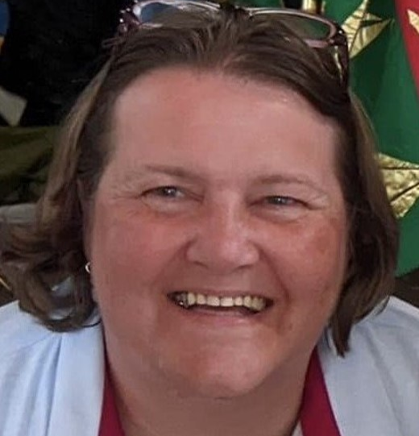
Kirstin Bosley
Role – Media Team Lead
I am looking forward to attending my first full WSIJ camp as the Media Lead volunteer having previously visited my daughters and their local guide and ranger units plus covering 'Wet Wednesday' for Sussex West county as the PR and social media lead in 2017. I enjoy the opportunities we get as adult volunteers, from taking part in the Lord Mayors Show to taking young members on international trips and volunteering at large scale events.
I have a particular love of nature and wildlife and everything being outdoors has to offer.
I am currently a unit leader, a LaSER Region trainer plus a Sussex West division commissioner and I'm really looking forward to welcoming some of our division guide and ranger units to experience everything WSIJ has to offer along with all the other guide and scout groups.
It has been great to be involved in the planning and set up of this camp which is looking like it will be full of fun, adventure and wonderful opportunities for our young members.

